Slide 2
FIT 152 Fundamentals of Information Technology
Lecture 8
Topic 4: Development and deployment of IT systems

Slide 3
FIT 152: Module outcomes
Upon successful completion of this course, the student will be able to:
Demonstrate an understanding of the relationship between IT and related and informing disciplines.
Demonstrate insight in the history of computing technology, and an understanding of the Internet, and the World-Wide Web, as well as the components of an IT system and how they interrelate.
Demonstrate an understanding of complexity in an information technology environment and how and why it occurs.
Demonstrate an understanding of why life-long learning and continued professional development is critical for an IT professional.
Illustrate the use of information and communication technologies to solve problems.
Demonstrate an understanding of how and to what extent IT has changed various application domains.

Slide 4
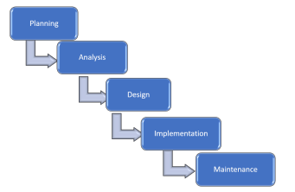
Systems {Software} Development Life Cycle (SDLC)
Read Gupta2020, Chapter 1
Read Pham2021, Chapter 10
SDLC is a model defining a process of a set of phases for planning, analysis, design, implementation, maintenance.

Slide 5
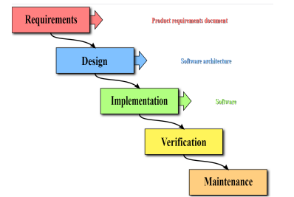
Systems {Software} Development Life Cycle (SDLC)
Read Cadle2014, Chapter 1 – 3
Read Pham2021, Chapter 10
Waterfall model
Often thought to be the same as SDLC
Each phase must be completed before the next one can begin
Rigid and linear progression through phases

Slide 6
Advantages and Disadvantage of SDLC and Waterfall
Advantages | Disadvantages
1) The robust process to control and track changes to minimize the number of risks can derail the project unknowingly. | 2) Take time to record everything, which leads to additional cost and time to the schedule.
3) Standard and transparent processes help the management of large teams. | 4) Too much time spent attending meetings, seeking approval, etc. which lead to additional cost and time to the schedule.
5) Documentation reduces the risks of losing personnel, easier to add people to the project. | 6) Some members do not like to spend time writing, leading to the additional time needed to complete a project
7) Easier to trace a problem in the system to its root whenever errors are found, even after the project is completed. | 8) It is difficult to incorporate changes or customers’ feedback since the project has to go back to one or more previous phases, leading teams to become risk-averse.

Slide 7
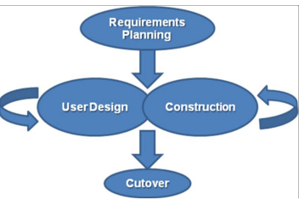
Different approaches: Rapid Application Development (RAD)
Read Pham2021, Chapter 10
RAD is a software development methodology that focuses less on planning and incorporating changes on an ongoing basis.
Requirements planning – planning, analysis and design phases of SDLC
User Design – Joint Application Development (JAD) session
Construction – implementation phase of SDLC
Cutover – system goes live
FOCUS:
User participation and iteration
Rapid prototyping
Minimum development time and cost

Slide 8
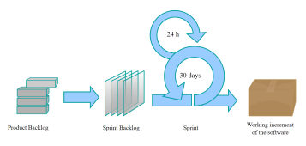
Different approaches: Agile Development methodologies
Read Pham2021, Chapter 10
Agile methodologies utilise incremental changes focusing on quality and attention to detail
Characteristics:
small cross-functional teams that include development-team members and users;
daily status meetings to discuss the current state of the project;
flexibility to accommodate changing requirements;
short time-frame increments (from days to one or two weeks) for each change to be completed; and
At the end of each iteration, a working project is completed to demonstrate to the stakeholders.
Example of an Agile Methodology: Scrum development model
Product Backlog – list of work to be done
Sprint Backlog – list of work in next sprint
Sprint – fixed time, daily meeting (scrum)
Working increment of software

Slide 9
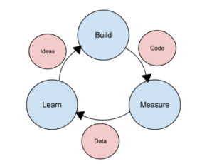
Different approaches: Lean methodology
Read Pham2021, Chapter 10
Lean methodology takes an initial idea and develop a minimum viable product (MVP).
MVP is a working application with just enough functionality to demonstrate the idea behind the project.
Characteristics:
Continuous improvement and waste reduction
Focus on delivery value quickly and efficiently

Slide 10
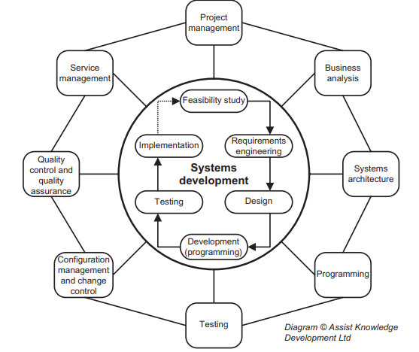
Systems development and other disciplines
Read Cadle2014, Chapter 1 - 3

Slide 11
Offshoring and outsourcing of software development
Offshoring – development resources in other countries
India
Ukraine
Downside: communication barriers, delays
Outsourcing – use specialist IT services firms and consultancies
BBD
BSG
Accenture
Dimension Data
BCX
Downside: lose control over systems

